Slide 1
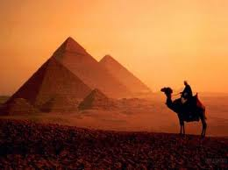

Slide 2
Transhumanism
A.I.
Singularity
life extension /
physical immortality

Slide 3
Genifer
“general inference engine”
hosted on Google Code

Slide 4







Some other AGI projects

Slide 5

Theory
higher-order logic, λ-calculus
Bayesian / causal networks, fuzzy-probabilistic logic
inductive learning
pattern recognition, associative memory
natural language understanding via logical inference

Slide 6
Virtual credits
contribute
$

Slide 7
Self-programming
“like a snake eating its own tail”

Slide 8
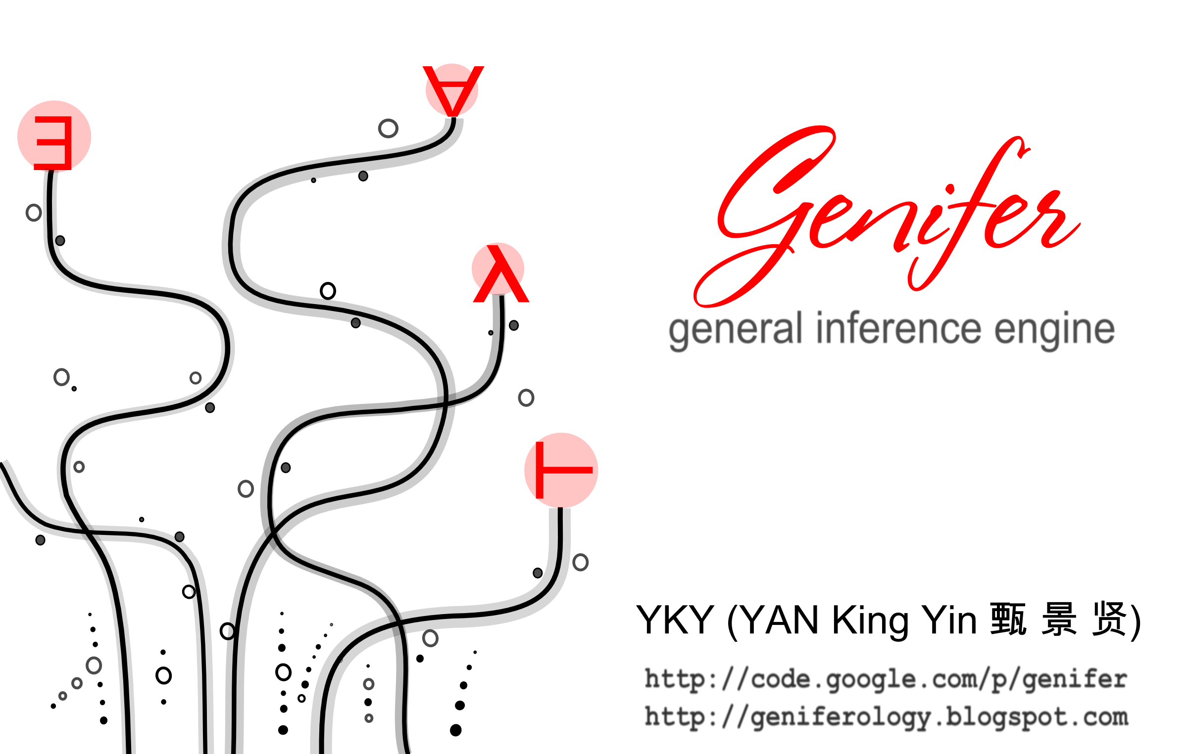
Questions / comments ?

